Slide 1
PFE-PKIS 5
Background and Opportunity

Slide 2
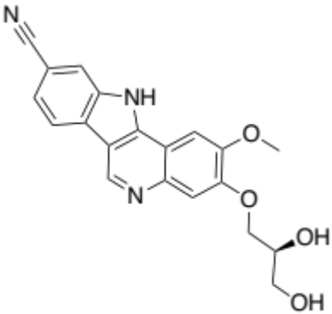
Indoloquinoline example PFE-PKIS 5
Found via HTS for IRAK4, an interesting target for inflammation
https://pubmed.ncbi.nlm.nih.gov/24726805/
Key features (proposed):
  Quinoline N forms H-bond with NH of kinase hinge region
  Nitrile in 9-position interacts with conserved catalytic lysine
  Ether substituents point towards solvent
  7, 8 positions nestled against gatekeeper Tyr
  Only IRAKs have Tyr gatekeeper
  Only about 15% of kinases have aromatic gatekeeper
9
8
7
PFE-PKIS 5
S₁₀ (1 𝜇M) = 0.08
S₁₀ (1 𝜇M) = 0.08
This means that the compound inhibits 8% of the human non-mutant kinases screened >90% when screened at 1 𝜇M

Slide 3
Reason for interest: not a common kinase inhibitor scaffold
Although quinoline is a well-known kinase hinge binding group, this particular ring system has not been vigorously explored, suggesting opportunity
Robust synthetic schemes and substitution at different positions will facilitate exploration of the kinase active sites and modulation of potency and selectivity

Slide 4
Reasons for interest: inhibitor of understudied kinases
The Illuminating the Druggable Genome (IDG) Project seeks to seed research on understudied proteins in tractable target classes like kinases
https://druggablegenome.net/#:~:text=Our%20Mission,ion%20channels%2C%20and%20protein%20kinases.
https://druggablegenome.net/IDGProteinList
Several targets of PFE-PKIS 5 are on this understudied list. New medicinal chemistry efforts around this scaffold may identify useful tools for some of these targets
PoC for understudied (IDG definition) kinases
STK17B = 0.3
MKNK2 = 0.6
PHKG2 = 0.8
STK17A = 1.3
PHKG1 = 4.5
HIPK1 = 5.6
HIPK3 = 5.8

Slide 5
Reasons for interest: identify new compounds for the kinase chemogenomic set (KCGS)
The KCGS is a set of kinase inhibitors that covers about half of the human kinome. The goal is to grow this set so that it contains inhibitors of each screenable kinase
More information can be found here: https://www.sgc-unc.org/kcgs
Some targets of PFE-PKIS 5 are not covered by compounds in the KCGS. New chemistry around this scaffold may identify compounds with appropriate features for inclusion in future iterations of KCGS (potency < 100 nM on kinase of interest, S₁₀ (1 𝜇M) < 0.04)
Targets of PFE-PKIS5 not covered in KCGS
IRAK4 = 0.1
ULK2 = 0.8
MYLK4 = 1
BUB1 = 5.7

Slide 6
Published kinase selectivity for analogues
https://pubmed.ncbi.nlm.nih.gov/24726805/

Slide 7
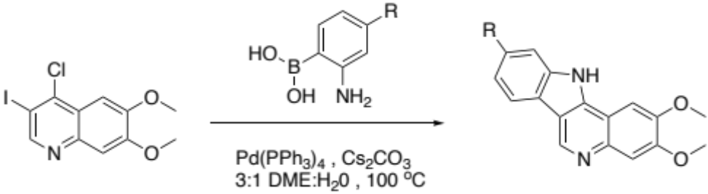
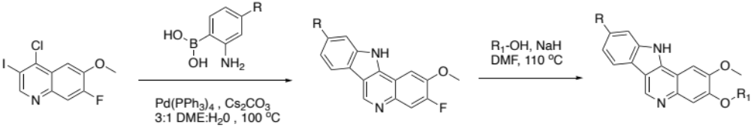
Key ring forming reaction
Also:
https://pubmed.ncbi.nlm.nih.gov/24726805/

Slide 8
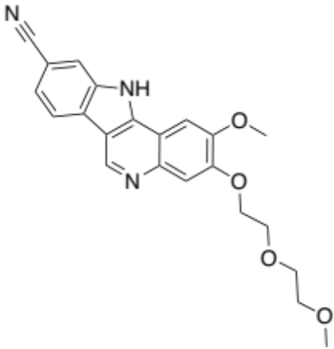
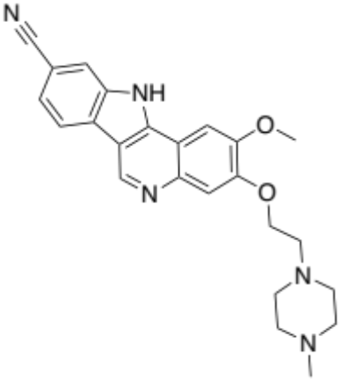
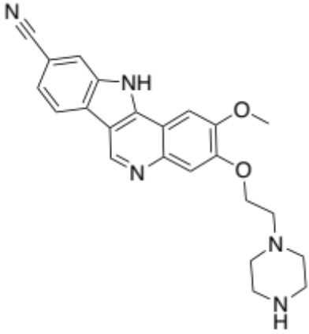
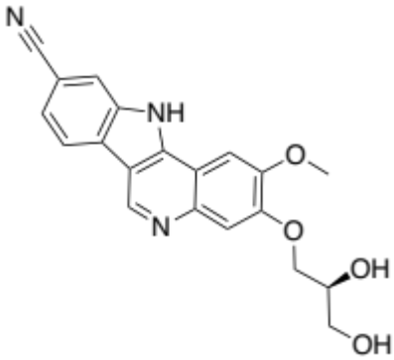
Four analogues with kinome scan
PFE-PKIS 5
S₁₀ (1 𝜇M) = 0.08
Not in Pfizer paper
PFE-PKIS 11
S₁₀ (1 𝜇M) = 0.082
Compound 32 in paper
PFE-PKIS 16
S₁₀ (1 𝜇M) = 0.117
Compound 24 in paper
PFE-PKIS 24
S₁₀ (1 𝜇M) = 0.112
Compound 25 in paper

Slide 9
Suggested screening strategy
Thermal shift assay (also known as differential scanning fluorimetry - DSF) on panel of kinases that includes kinases not covered in KCGS and IDG understudied kinases
NanoBRET assays on hits for these kinases
Broad screening (kinomescan) of new interesting compounds

